Slide 1
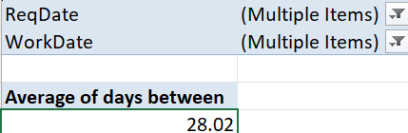
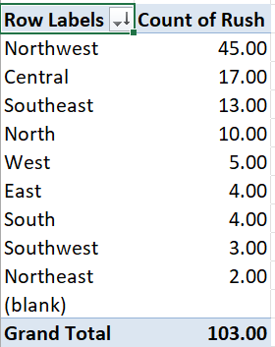
Case study 1:-
->The average lead time between the requested date and the compliant date is calculated by using the formula days
-> By inserting the pivot adding filter of blanks we got the average time between the request date and the completion date is found out to be 28.02
Case study 2:-
To find the district which has the highest rush jobs we need to take the attributes or columns like district and rush sort it.

Slide 2
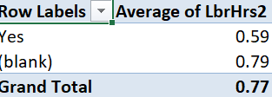
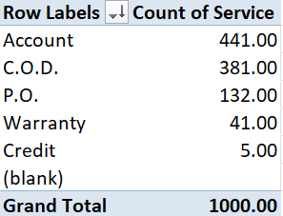
Case study 3:-
->The average labour hours are varies as 0.59 for rush labour and 0.79 for the non-rush labours
->in order to get this insigths I used pivot between rush and average working hours
Case study 4:-
->the distribution of payment types and the services is visualized used bars graph
->this is done using pivot between payment and services

Slide 3
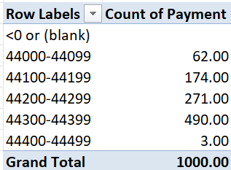
Case study 5:-
The trend of payment is visualized using line graph and that is done using pivot

Slide 4

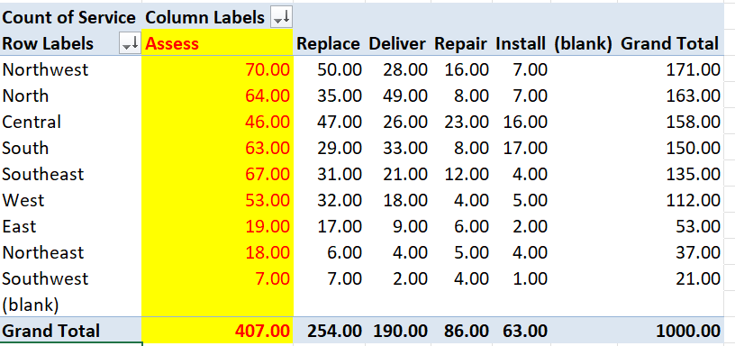
Case study 6:- they ask that there is a correlation between the technicians required and the cost for parts no there is a positive correlation between them of correlation value is 0.24
Case study 7:- the most common service requested in each district is Assess
-> It obtained using pivot table the serive and districts are taken into consideration

Slide 5
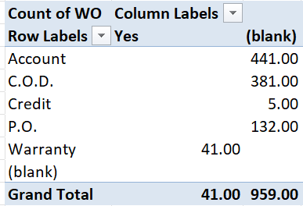
Case study 8:-
The distribution for work orders with warrenty labor is very lesser than non warrenty labour
-> The total count of the warranty labour is 41 and non warranty labour are 959 which is the 4% of the warranty labour are distributed overall

Slide 6
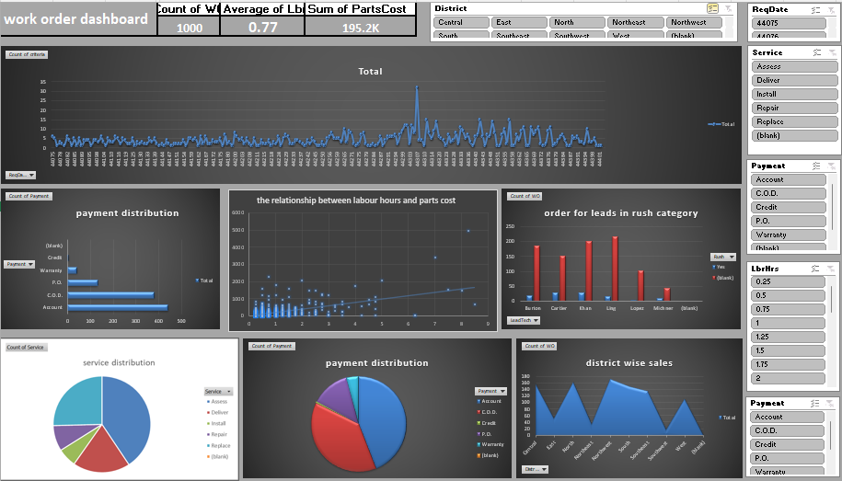
dashboard

Slide 7
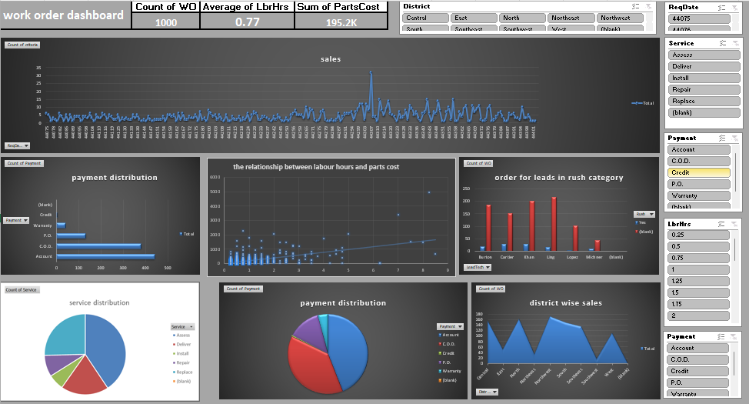

Slide 8
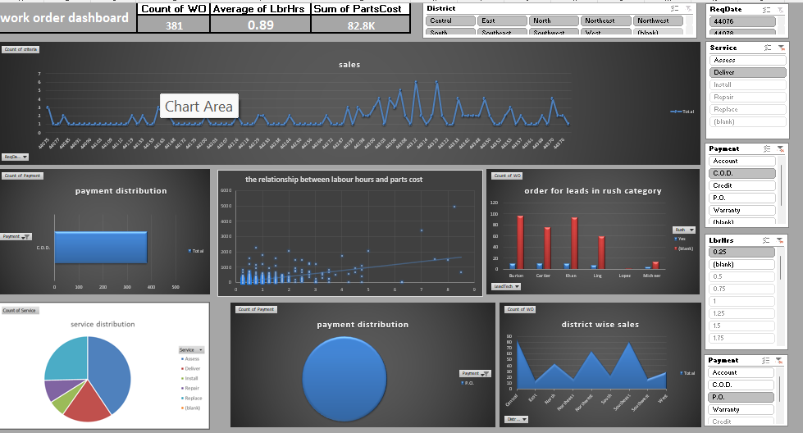

Slide 9
The dashboard shows so many insights
Its shows the trend of the categeory
It shows total cost
It shows the distribution of services
It shows the distribution of payment types
The completion rate is included
A bar graph s ploted between work orders and service type
Competion rate per month is includes
Thedistribution of payments are in cluded
The slicer are included to get the values filtered and can be analyzed in the required manner

